Slide 1
Activating Identities and Futures
@
2023 2nd SACE Pilot

Slide 2
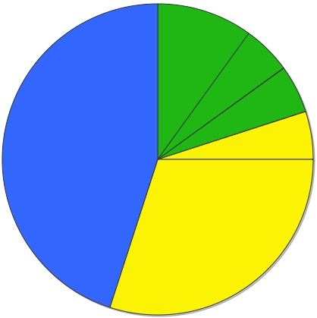
Your SACE
Compulsory Stage 1
40 Credits
Compulsory Stage 2
70 Credits
‘C’ Grades or better
PLP 10 Credits
Activating IF
- 10 Credits
Numeracy 10 Credits
Literacy 20 Credits
‘C’ Grades or better
Stage 2 Subjects & Courses
60 Credits
Grades A to E
Compulsory Stage 1 = 40 Credits
Compulsory Stage 2 = 70 Credits
Additional choices = 90 Credits
SACE = 200 Credits
Modified subjects for students with significant disabilities
Research Project A and B will count towards your ATAR score*
.
Notes:
Let’s remind ourselves of the new SACE requirements
We know that many of you may have seen this diagram before and maybe for others it will be new. But it makes good sense at the beginning of our day to refresh ourselves about the structure and requirements of the new SACE.
The new SACE has started this year with a 10 Credit Compulsory Stage 1 subject, the Personal Learning Plan (PLP) . This is deliberately positioned as the first subject to support student goal setting and review of skills. We’ll focus more on the PLP later.
The other compulsory requirements are Numeracy 10 Credits and Literacy 20 Credits. There are compulsory subjects at Stage 1 of 40 Credits. In these students need a ‘C’ or better for SACE completion requirements.
At Stage 2, the Research Project [ starting in 2011] is compulsory and contributes 10 Credits with Stage 2 Subjects & Courses contributing a further 60 credits to complete the 70 compulsory credits required. The 70 Stage 2 Credits also need a ‘C’ Grade or better.
Additional subjects & courses of 90 credits are free choice and they can be either stage 1 or 2 to make a total of 200 credits.
There are also a number of Modified subjects being developed based on achievement against personal goals for students with significant disabilities.

Slide 5
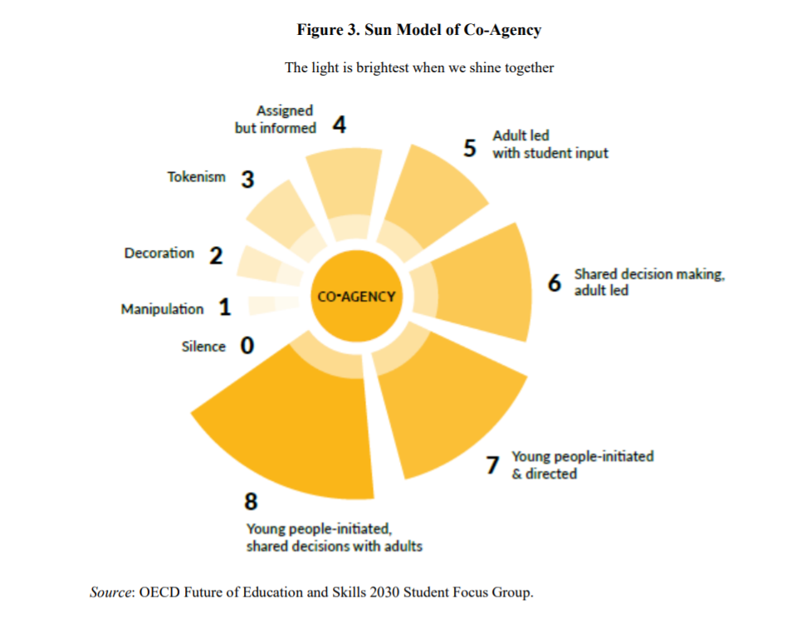
Which
Number
Are you?

Slide 6
External SACE Assessment
School/Teacher Assessed
AT1 PORTFOLIO 30%
Curation of ‘natural’ evidence that demonstrates student agency and activity as they progress the learning
AT3 APPRAISAL 30%
Appraising the learning process and learning output
SACE Moderated
AT2 PROGRESS CHECK 40%
An assessment of the progress made toward an intended output at particular stages in the learning
One OR more Progress Checks can occur.
1,500 words/10 minutes max.
1,000/6mins max

Slide 7
AT1: Portfolio
no prescribed assessment conditions for this Assessment Type to facilitate natural evidence (ie. Should see ‘formative’ work here)
30% School Assessment
Students are exploring areas of interest (E1), expanding and/or refining their exploration through perspectives (other people/sources) (E3) and applying purposeful selection of strategies (E2), in reference to their appraisal of value and purpose (self, others and/or community)(A1). They plan and monitor their progress (PA1).
Notes:
Students:
explore a focus area that is of personal interest
consider the value and purpose of their topic to self and/or others and/or the community
explore and select strategies to move their learning forward
actively seek perspectives (people/ books/ websites)
demonstrate agency in developing and following a plan to manage time and resources
Evidence can include (examples, not exhaustive list):
Plans, designs, sketches
concept maps, charts, murals
prototypes, experiments
Video/ audio recordings
articles or excerpts
annotated photos

Slide 9
Activating IF: Types of ‘Natural Evidence’ for Portfolio
Photograph/s
Video
evidence
List/s
Recording of conversation/s or Discussion/s
Certificate/s
Text message/s
Website/s
Discussion/s
Diary or
Journal
Social Media interactions /posts
Scrapbook
Chart/s or Graph/s
Flow chart
Game results
Personal Communication
Bulletin Notices
YouTube video/s
Quiz/es
Or
Assessments
Demonstration
Re-enactment
Survey/s
Email/s
or Letter/s
Journal / Magazine articles
Painting, Drawing/s
or
Sketch/es
Diagram
Voice Recording/s
Live performance
Word splash
Physical object/s
Phone recording/s
Journal / Magazine articles
Show and tell
Experiment/s
Map/s
Glossary / Dictionary meanings
Blog/s
Data records
Interview/s
Phone Applications
Spreadsheet/s
Lesson notes
Concept map
Timeline

Slide 10
AT2: Progress Checks
This is an assessment type that can encompass one or more assessment tasks ie. One or more progress checks can occur
1,500 words/9 minutes max combined total.
40% School Assessment
Students are reviewing feedback (PA2), identifying the significance/impact of strategies and/or perspectives (A2) and discerning next steps (PA3)
Notes:
One or more tasks within this assessment type
Students:
discuss the progress of their learning in relation to their intended output
evaluate the relative impact of different strategies and perspectives they have utilised to this point
consider which strategies and perspectives they will select to continue progress towards intended output
reflect on how specific feedback has assisted in refining their learning intention and progress to date, indicating what actions have been taken in response to significant feedback
plan who they will seek feedback from next and justify how this feedback might be used to progress their learning.
Evidence:
combined maximum of 1500 words if written, 10 minutes if oral, or the equivalent in multimodal form.
can include but isn’t limited to:
Presentation
audio or video recording
a discussion with peers/ teacher/mentor
report

Slide 11
Symbiotic relationship between AT1 & AT2
Student draws from evidence in Portfolio to stimulate reflective practice in Progress Check
Student uses feedback (PA2) insights, experiences (A2) and decisions (PA3) from Progress Check to inform planning (PA1) and other actions (E1,2,3,) which form part of the Portfolio
AT1 – Portfolio
AT2 – Progress Check
Notes:
Progress Checks are pivot points for looking back, evaluating current position and projecting forward the next actions that will emerge in the Portfolio

Slide 12
30% External Assessment
1000 words maximum/ 6 mins multimodal equivalent
Appraise their Learning Goals, Output of Learning and achievement along the way.
A1 Appraising the value of the learning
A2 Evaluating the impact of strategies, perspectives and/or feedback on the learning process
A3 Appraising the Output of Learning
AT3: Appraisal
Notes:
Students:
share their output of learning (product/ prototype/plan)
appraise the value and purpose of the learning for themselves and/or others and/or the community
evaluate the most significant factor/s (strategies, perspectives and/or feedback) that contributed to their learning process and output
may also project future benefits related to transfer of skills and knowledge, development of connections and capabilities.
Evidence:
maximum of 1000 words if written, a maximum of 6 minutes if oral, or the equivalent in multimodal form.

Slide 13
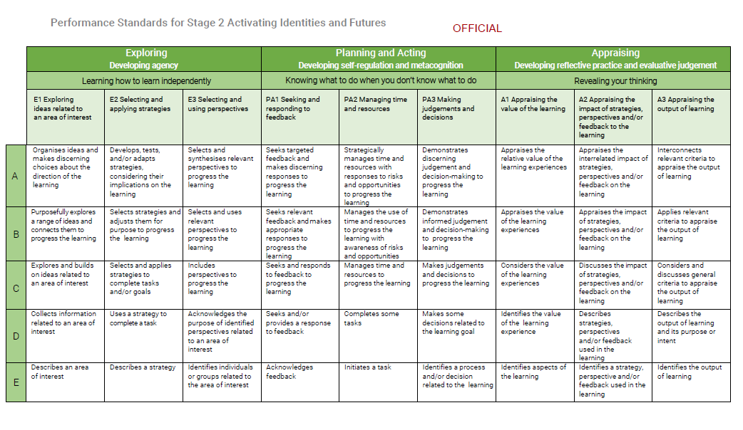

Slide 14
Key Due Dates and Check Points
Term 1 | Term 2
Week 1 – Introduction to subject, mind mapping, setting up One Note, set Learning Intention, and begin collection of Natural Evidence. Week 2 – Have topic and proposed draft Learning Intention, continue collection of “natural evidence” Week 3 – First Progress Check Weeks 4 to 8 – Portfolio – continue learning and collection of Natural evidence. Week 9 to 10 – Second Progress Check/s Week 11 – Ongoing learning and collection of evidence, aim to complete learning output. | Week 1 – Presentation of Learning Output Week 2 – Identify any Key Learning for Appraisal Week 4 – Finalise and summarise key learning or product Week 5 – Final Progress Check if required Week 7 – Appraisal Draft Week 9 – Final Appraisal submitted to SACE for external assessment

