Slide 1
Activating Identities and Futures 2024: An Introduction

Slide 2
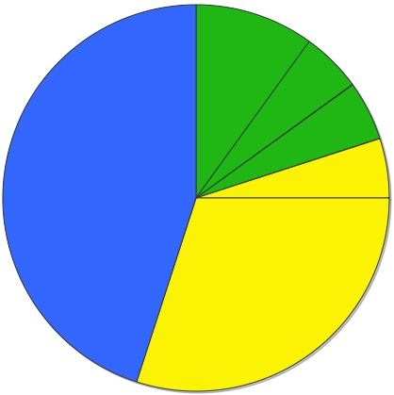
Your SACE
Compulsory Stage 1
40 Credits
Compulsory Stage 2
70 Credits
‘C’ Grades or better
PLP 10 Credits
Activating IF
10 Credits
(Compulsory)
Numeracy 10 Credits
Literacy 20 Credits
‘C’ Grades or better
Stage 2 Subjects & Courses
60 Credits
Grades A to E
Compulsory Stage 1 = 40 Credits
Compulsory Stage 2 = 70 Credits
Additional choices = 90 Credits
SACE = 200 Credits
Modified subjects' options for students with significant disabilities
AIF will form part of an ATAR score

Slide 3
What is Activating Identities and Futures?
Name: AIF, Activating IF etc… NOT Research Project
Activating Identities and Futures: 10-credit Stage 2 subject.
Fostering lifelong learning, independent thinking.
Students pursue self-selected Learning Goals.
Emphasises feedback, metacognition, and purposeful outputs.
Diverse approaches, tailored to individual journeys.
Builds on from Exploring Identities and Futures (EIF).

Slide 4
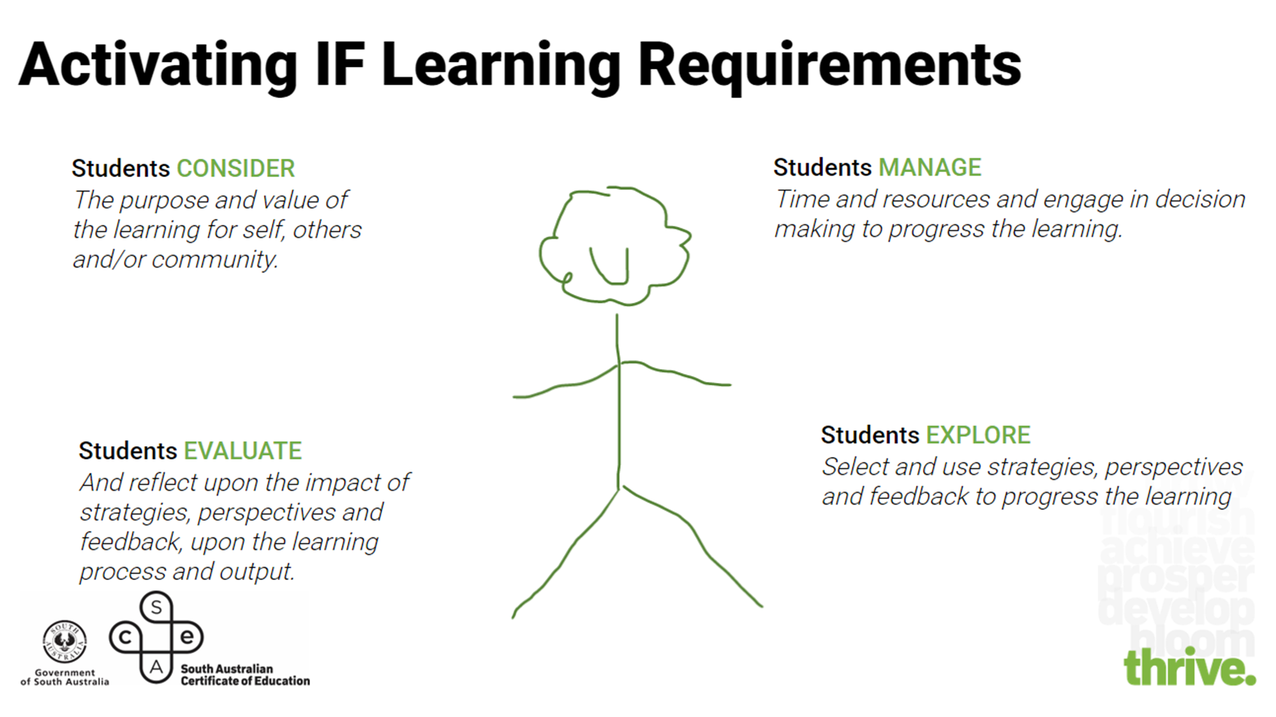

Slide 5
Key Concepts in AIF
(and SACE):
Agency
Metacognition
Self Regulation
Reflective Practices
Evaluative Judgement
Feedback
Perspectives
Natural Evidence of Learning

Slide 6
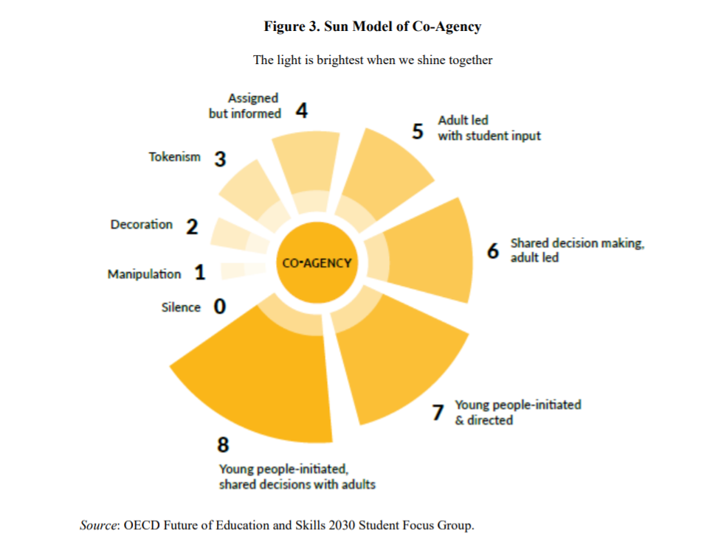
Which
Number
Are you?

Slide 8
External SACE Assessment
School/Teacher Assessed
SACE Moderated
AT3 APPRAISAL 30%
Appraising the learning process and learning output
AT1 PORTFOLIO 35%
Curation of ‘natural’ evidence that demonstrates student agency and activity as they progress the learning
AT2 PROGRESS CHECKS 35%
An assessment of the progress made toward an intended output at particular stages in the learning
1,000/6mins max
One OR more Progress Checks can occur.
1,500 words/10 minutes max.

Slide 9
AT1: Portfolio
35 %
Assessment Type 1: Portfolio
Personal Learning Goal exploration, that has value and purpose.
Selection of relevant strategies.
Actively seek feedback
Demonstrate agency and reflection.
Unlimited Natural evidence of learning (photos, articles, etc.).
No prescribed assessment conditions, evidence, including the volume of work and hours spent, should be equal to that of a 10 credit, Stage 2 subject.
Criteria:
Exploring (E1, E2, E3)
Planning and Acting (PA1).

Slide 10
Activating IF: Types of ‘Natural Evidence’ for Portfolio
Photograph/s
Video
evidence
List/s
Recording of conversation/s or Discussion/s
Certificate/s
Text message/s
Website/s
Discussion/s
Diary or
Journal
Social Media interactions /posts
Scrapbook
Chart/s or Graph/s
Flow chart
Game results
Personal Communication
Bulletin Notices
YouTube video/s
Quiz/es
Or
Assessments
Demonstration
Re-enactment
Survey/s
Email/s
or Letter/s
Journal / Magazine articles
Painting, Drawing/s
or
Sketch/es
Diagram
Voice Recording/s
Live performance
Word splash
Physical object/s
Phone recording/s
Journal / Magazine articles
Show and tell
Experiment/s
Map/s
Glossary / Dictionary meanings
Blog/s
Data records
Interview/s
Phone Applications
Spreadsheet/s
Lesson notes
Concept map
Timeline

Slide 12
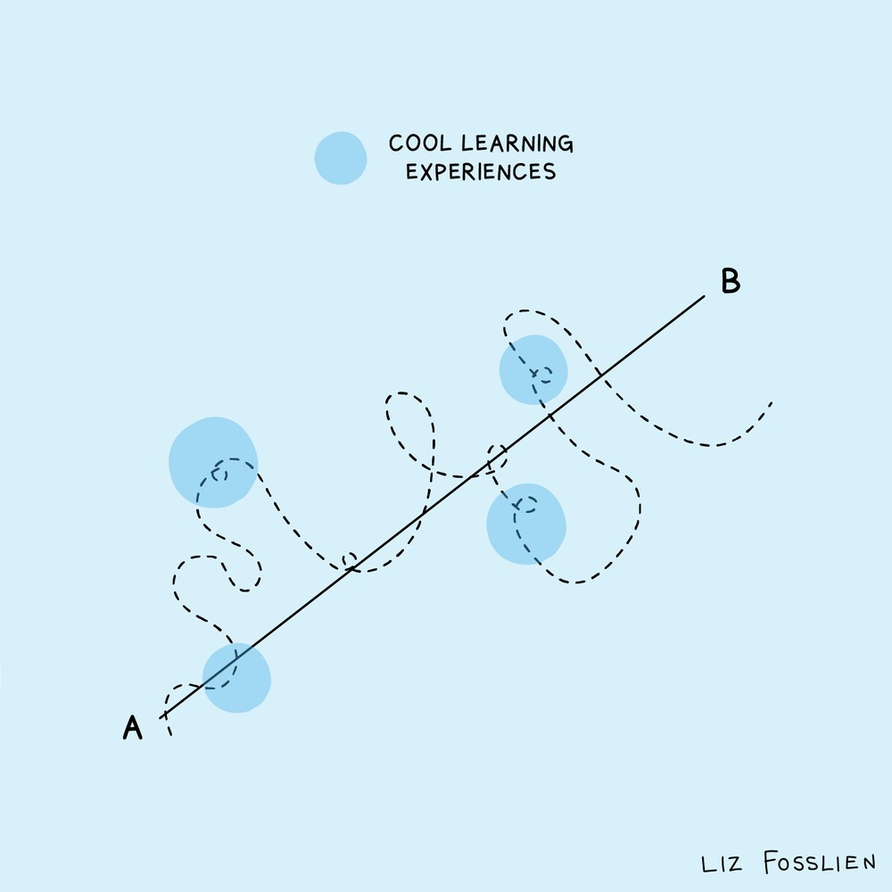

Slide 13
Portfolio Assessment Standards
 | Exploring Developing agency |  |  | Planning and Acting Developing self-regulation and metacognition
 | Learning how to learn independently. |  |  | Knowing what to do when you don’t know what to do
 | E1 Exploring ideas related to an area of interest | E2 Selecting and applying strategies | E3 Selecting and using perspectives | PA1 Seeking and responding to feedback.
A | Organises ideas and makes discerning choices about the direction of the learning | Develops, tests, and/or adapts strategies, considering their implications on the learning | Selects and synthesises relevant perspectives to progress the learning | Seeks targeted feedback and makes discerning responses to progress the learning.
B | Purposefully explores a range of ideas and connects them to progress the learning | Selects strategies and adjusts them for purpose to progress the learning | Selects and uses relevant perspectives to progress the learning | Seeks relevant feedback and makes appropriate responses to progress the learning.
C | Explores and builds on ideas related to an area of interest | Selects and applies strategies to complete tasks and/or goals | Includes perspectives to progress the learning | Seeks and responds to feedback to progress the learning.
D | Collects information related to an area of interest | Uses a strategy to complete a task | Acknowledges the purpose of identified perspectives related to an area of interest | Seeks and/or provides a response to feedback.
E | Describes an area of interest | Describes a strategy | Identifies individuals or groups related to the area of interest | Acknowledges feedback.

Slide 14
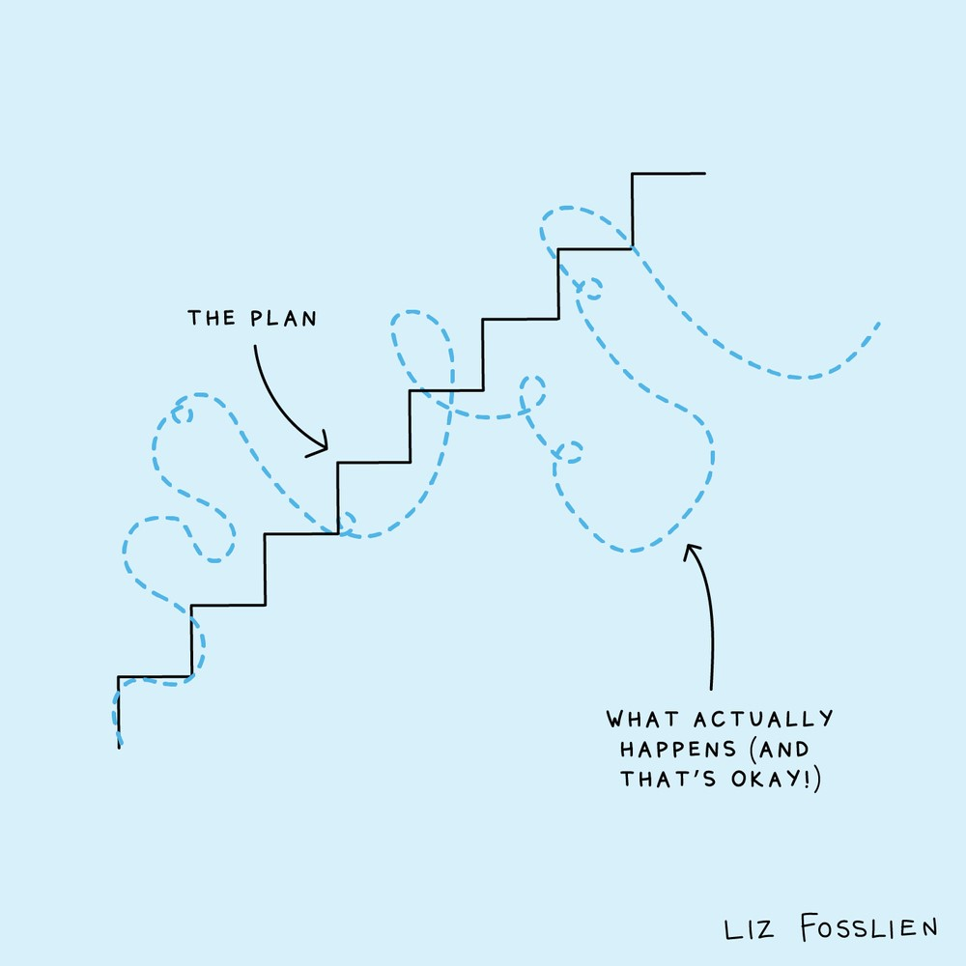
Learning Goal and Output of Learning
Students take agency and ownership over their learning as they select, test, and explore relevant strategies and perspectives in the pursuit of a Learning Goal of their choice.
Each student will have a different learning journey that they tailor to their Learning Goal.
Approaches, contexts, and strategies will vary to suit the individual student.
An Output of Learning, for example, could be a plan for future action, a proposal for a service or social enterprise, an oral explanation, a demonstration of a skill, or a completed product such as an artwork, report, academic article, or short video.
Both the Learning Goal and the Output of Learning need to have purpose and value
The Output of learning must be evidenced in the Appraisal (but doesn’t count towards the Word/Minute count)

Slide 16
AT2: Progress Checks
35 %
2 or more Progress Checks
Total: 10 minutes / 1500 words max.
Discuss learning progress related to the intended Learning Goal.
Use Portfolio examples as evidence and reference points.
Evaluate impact of strategies, perspectives, and feedback.
Explain and appraise decisions at each Progress Check.
Display metacognitive skills through retrospective and prospective reflection.
Progress Checks strategically occur, chosen collaboratively by student and teacher.
Allow sufficient time between Progress Checks and Appraisal for development.
Evidence may be written, oral, or multimodal.
-Authentic evidence for moderation, not contrived.
Criteria:
Planning and Acting (PA2, PA3) • Appraising (A2)

Slide 17
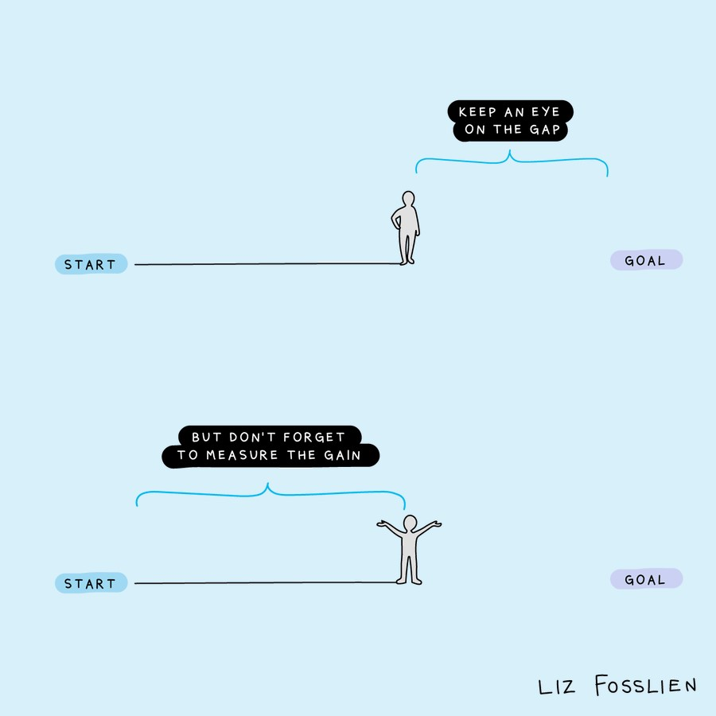

Slide 18
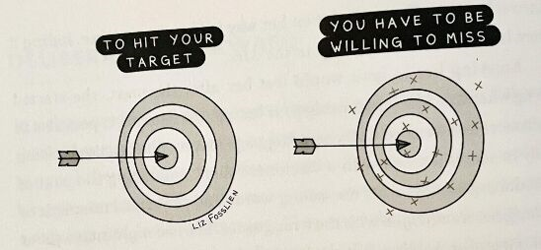

Slide 19
Progress Checks Assessment Standards
 | Planning and Acting Developing self-regulation and metacognition |  | Appraising Developing reflective practice and evaluative judgement
 | Knowing what to do when you don’t know what to do |  | Revealing your thinking
 | PA2 Managing time and resources | PA3 Making judgements and decisions. | A2 Appraising the impact of strategies, perspectives and/or feedback to progress the learning towards the learning goal
A | Strategically manages time and resources with responses to risks and opportunities to progress the learning | Demonstrates discerning judgement and decision-making to progress the learning | Appraises the related impact of strategies, perspectives, and/or feedback to progress the learning towards the learning goal
B | Manages the use of time and resources to progress the learning with awareness of risks and opportunities | Demonstrates informed judgement and decision-making to progress the learning | Appraises the impact of strategies, perspectives, and/or feedback to progress the learning towards the learning goal
C | Manages time and resources to progress the learning | Makes judgements and decisions to progress the learning | Discusses the impact of strategies, perspectives, and/or feedback to progress the learning
D | Completes some tasks | Makes some decisions related to the learning goal | Describes strategies, perspectives, and/or feedback used in the learning
E | Initiates a task | Identifies a process and/or decision related to the learning | Identifies a strategy, perspective, and/or feedback used in the learning

Slide 20
Symbiotic relationship between AT1 & AT2
Students draws from evidence in Portfolio to stimulate reflective practice in Progress Checks
Students use feedback (PA2) insights, experiences (A2) and decisions (PA3) from Progress Checks to inform planning (PA1) and other actions (E1,2,3,) which form part of the Portfolio
AT1 – Portfolio
AT2 – Progress Check
Notes:
Progress Checks are pivot points for looking back, evaluating current position and projecting forward the next actions that will emerge in the Portfolio

Slide 21
30 %
Externally Assessed by SACE
AT3: Appraisal
Assessment Type 3: Appraisal
Criteria:
Appraising (A1, A2 and A3).
The focus is on evaluating the significance and purpose of their learning experience for personal development.
Students analyse the impact of strategies, perspectives, and feedback
This Output does not contribute to the word count or time limit.
Written appraisals are a maximum of 1000 words, or 6 minutes of oral and multimodal.
Appraisals include anticipating future benefits, such as skill transfer, knowledge application, and building connections.
Students exhibit their Output of Learning, assessing it in relation to personal learning development and chosen goals.
Students showcase their Output of Learning to demonstrate progress or achievement of Learning Goals.

Slide 22
Appraisals Examples
Learning goal | Output of learning | Appraisal
To learn about sustainable farming practices to use on their farm. | A recorded discussion of the student with their parent of their main findings. | The Appraisal is a written response of 1000 words with the recording/transcript of the discussion attached.
To rebuild parts of a car engine | Two pages of annotated photos showing how the car engine was reconditioned. | The Appraisal consists of a 6-minute audio recording where the student references the photos as they are speaking.
To design and handknit a jumper | The nearly completed jumper. | The Appraisal is a 6-minute video, including the student wearing the jumper.
To make a short film in the horror genre | A storyboard with annotations of techniques and horror influences, with some uncut practice footage. | The Appraisal consists of a 6-minute screencast of their materials accompanied by a student voiceover.
To research recent innovations in cochlear implants and their support of speech development in children | Scientific article written for publication in a magazine. | The Appraisal consists of a 1000-word discussion in the form of paragraph annotations around

Slide 23
 | Appraising Developing reflective practice and evaluative judgement
 | Revealing your thinking
 | A1 Appraising the personal value of the learning experiences | A2 Appraising the impact of strategies, perspectives and/or feedback to progress the learning towards the learning goal | A3 Appraising the learning development as represented in the output of learning
A | Insightfully appraises the personal value of the learning experiences | Appraises the related impact of strategies, perspectives, and/or feedback to progress the learning towards the learning goal | Appraises the extent of learning development, using interconnected measures, as represented in the output of learning
B | Appraises the personal value of the learning experiences | Appraises the impact of strategies, perspectives, and/or feedback to progress the learning towards the learning goal | Appraises the extent of learning development as represented in the output of learning
C | Considers the personal value of the learning experiences | Discusses the impact of strategies, perspectives, and/or feedback to progress the learning | Discusses how the output of learning represents progress towards the learning goal
D | Identifies the value of the learning experience/s | Describes strategies, perspectives, and/or feedback used in the learning | Describes the relationship between the output of learning and
E | Identifies aspects of the learning | Identifies a strategy, perspective, and/or feedback used in the learning | Identifies the output of learning and/or learning goal
Appraisal Assessment Standards

Slide 24
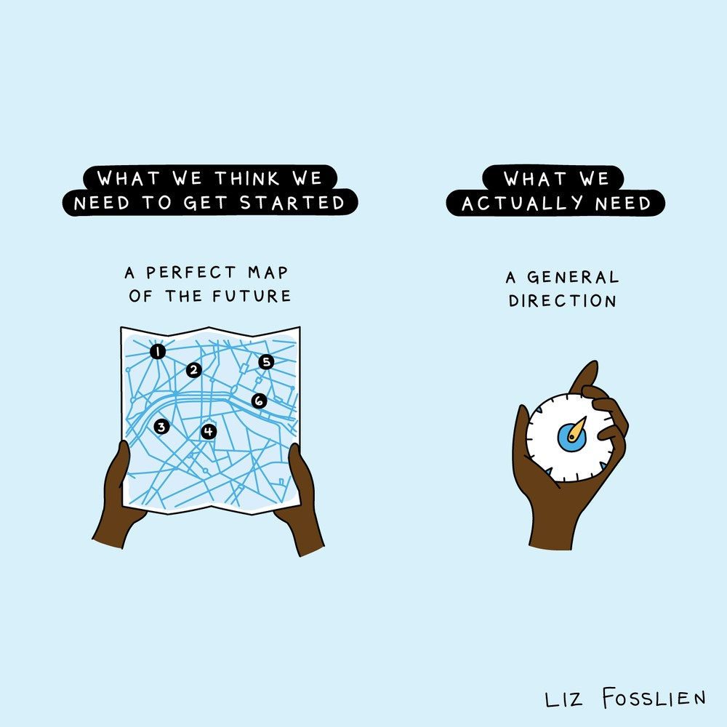
Getting Started
Brainstorm, mind map, list, Thinker’s Keys etc
Explore, watch and read
Discuss with others, friends, family
Consider your hobbies, interests and passions
Find a problem, solve it.

Slide 25
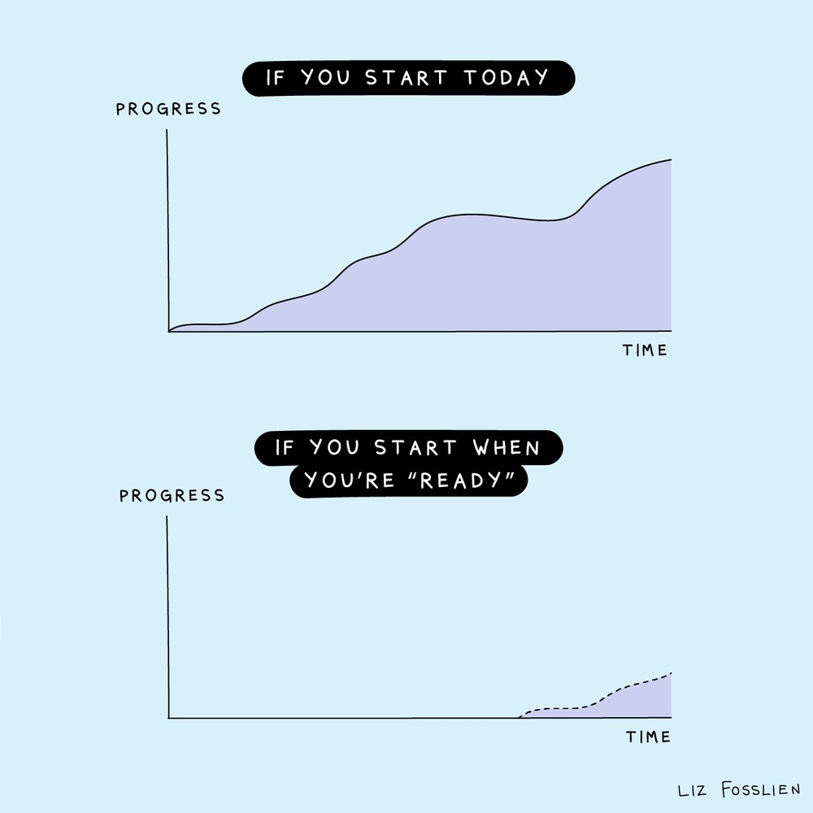

Slide 26
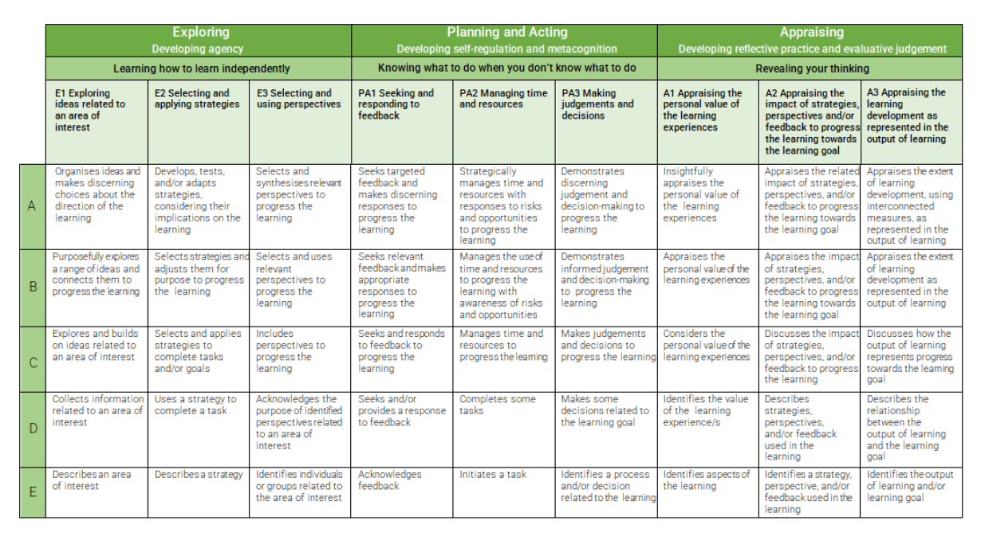
Assessment Criteria and Performance Standards

Slide 27
Key Due Dates and Check Points
Term 1 | Term 2
Week 1 – Introduction to subject, mind mapping, setting up One Note, set Learning Intention, and begin collection of Natural Evidence. Week 2 – Have topic and proposed draft Learning Intention, continue collection of “natural evidence” Week 3 – Peer to Peer feedback Week 4 – First Progress Check Weeks 4 to 8 – Portfolio – continue learning and collection of Natural evidence. Week 9 – Second Progress Check/s Week 11 – Ongoing learning and collection of evidence, aim to complete learning output. | Week 1 – Presentation of Learning Output Week 2 – Identify any Key Learning for Appraisal Week 4 – Finalise and summarise key learning or product Week 5 – Final Progress Check if required Week 7 – Appraisal Draft Week 8 – Final Appraisal submitted to SACE for external assessment

