Slide 1
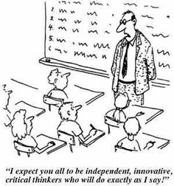
Assessing Research Based Learning:
Using Higher Order Thinking Skills to promote authentic assessment of ‘critical analysis’ information literacy and similar achievement/performance standards in research based learning tasks
19 May 2016
Adam Fitzgerald Teacher Librarian @thielelibrary
Notes:
The purpose of this PD session is to provide you with an more ‘authentic’ way to teach and assess Research or Inquiry Based Learning.

Slide 2
Why teach RESEARCH or INQUIRY?
It says so in the Curriculum.
To give students more control of their learning
I don’t know everything on my subject area.
These are important skills for 21st Century learners to have.
Why not just set a test?
Notes:
Firstly consider the reasons why you would set a Research Based Learning task, and what your own biases might be towards this type of Assessment. Is it just knowledge that you need students to know, in which case a test might more appropriate.

Slide 3
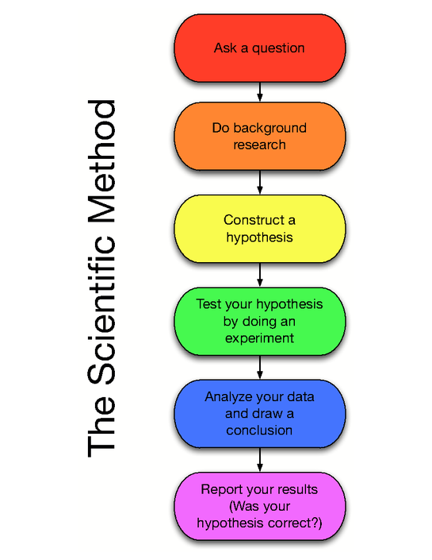
SOME INQUIRY RESEARCH PROCESSES
Research Project Design
PLANNING
DEFINING (Brainstorming, Planning, Initiating)
LOCATING (Keywords, Searching, Interviewing, Surveying, Communicating)
SELECTING (Appropriate information)
ORGANISING (Plans, Headings etc)
PRESENTING / ACTIONING (Essays, PowerPoint, Making or doing, Synthesising).
EVALUATING / ASSESSING (Meta-cognition, Reflecting on the ‘process’).
*This a commonly called the ‘Big 6’ Inquiry Process or something similar.
DEVELOPMENT
SYNTHESIS
EVALUATION
Notes:
The Inquiry or Research Process is often called many different things, but is actually quite similar. Each tends to start with a ‘Defining’ section, which is most often done by the teacher, although more and more the Curriculum Standards will ask students to ‘formulate questions. This works through the typical ‘research’ stage of finding and noting information, to producing and product, outcome or result. Most often this is where it ends, although some subjects also ask for the student to become involved in the ‘Evaluation’ or ‘Assessment’ of Learning.

Slide 4
What is Assessment?
Four ‘core fundamentals to assessment’:
Assessment helps students determine strengths and weaknesses to improve
Assessment is equally valuable in analysing information and informing instruction
Assessment is not evaluation
Assessment is not an ‘add-on’ and is integral to teaching and learning
(Harada and Yoshina, 2005 cited in Kuhlthau, Maniotes and Caspari, Guided Inquiry : Learning in the 21st Century, 2007).
Notes:
Assessment should work towards, ‘Assessment of Learning’, ‘Assessment for Learning’ towards ‘Assessment as Learning.’ 1. All assessment should be about learning, in that it should aim to help students determine their strengths and weaknesses in order to improve. 2. We should be working towards a common understanding of what constitutes successful or unsuccessful teaching and learning. 3. Assessment should not only be a ‘post-mortem’ exercise, but ideally should always help inform further learning or achievement. 4. Assessment is not a distraction or ‘optional extra’ to learning, after the fact.

Slide 5

A Brief History of Assessment
https://www.youtube.com/watch?v=7lBhMSaFNhY
Notes:
Given the unknown nature of the types of work that our students, and possibly children, are likely to enter, how do we teach and then assess these skills Sometimes skills and capabilities such as ‘critical literacy’ are difficult to access, and can’t be done in Assessments such as tests.

Slide 6
Five Kinds of Learning in the Inquiry Process
1. Curriculum content | fact finding, interpreting and synthesizing
2. Information literacy | concepts for locating, evaluating and using
3. Learn how to learn | initiating, selecting, exploring, focusing, collecting and presenting
4. Literacy competence | reading, writing, speaking and listening
5. Social skills (Group work) | interacting, cooperating and collaborating
Kuhlthau, Maniotes and Caspari, 2007, p 112.
Notes:
The ‘learning’ that occurs during a research process is not always what is just written in the Curriculum documents, task sheet or on the Achievement / Performance Standards. Research Based Learning, or ‘Guided Inquiry’ (as described by Kuhlthau, Maniotes and Caspari), often involves other types of ‘learning’ that could be also Assessed. It is important to note that

Slide 7
Authentic Assessment Design:
How does the assignment match the Standards?
Research’ skills might be framed in Performance or Achievement Standards in different words, such as:
formulates geographical inquiry questions (Geography Year 11 AC)
‘Critical Analysis and Evaluation’ (Stage 2 SACE PE)
“develop questions to frame a historical inquiry” (Year 8 Australian History, Australian Curriculum)
“analysing information to make informed choices (for example, when purchasing goods and services)” (Year 10 Economics and Business, Australian Curriculum)
Notes:
To ensure Assessment is valid and reliable it should aim firstly to address the Standards (also known as ‘Backward Design’ model). In research or inquiry however, these Standards often, particularly for the higher levels of achievement (As and Bs etc) require deeper or Higher Order Thinking.

Slide 8
Authentic Assessment is:
“Disciplined inquiry that integrates and produces knowledge, rather than reproduces fragments of information others have discovered.” (Newman, cited in Burke 2008)
“Methods that emphasize learning and thinking, especially higher-order thinking skills such as problem solving strategies.” (Collins)
Notes:
Inquiry or Research Based Learning should aim to insist upon Higher Order Thinking Skills, rather than a straight transfer of knowledge or information (eg cutting and pasting).

Slide 9
Socratic Questioning
“Thinking is not driven by answers,
but by questions”
(Richard Paul, Cricticalthinking.org)
Research questions:
Clarify
Probe Assumptions
Questions reasons and ask for evidence
Question view points and perspectives
Question implications and consequences
Question the ‘facts’, the question, thinking or task
Notes:
Some Standards insist that students ‘create questions’ or at least topics. Whether research questions or topics are created by the teacher or student, some ‘Socratic Questioning’ can encourage students to move just beyond the recall of facts.

Slide 10
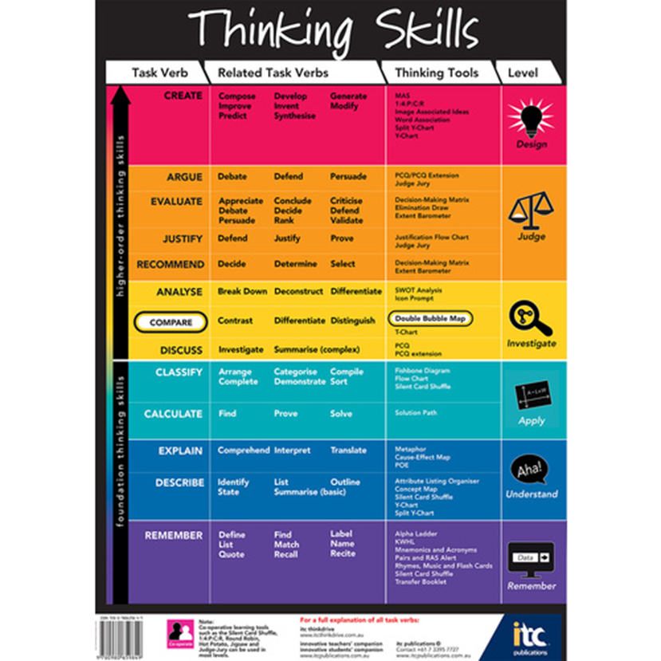

Using HOTS in Research Task Design
How might you justify the moving of the world’s Polar Bear population to Antarctica?
Create a plan for this to occur?
Pretrik, P 2009, Lets Take a Trip on Animal Airways, Top That Publishing, United Kingdom.
Notes:
The questions that we ask, or ask to students to ask of themselves, need to aim to promote Higher Order Thinking Skills (Investigate, Analyse, Justify Judge, Design or Create etc) not merely recall or ‘move information’ from one source to their assignment (Recall, Explain, Remember etc). This is not to say that the ‘Foundation Thinking Skills’ do not have a place in learning, as they can inform the HOTS.

Slide 11
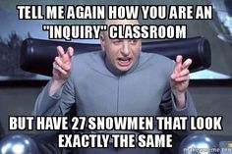
Notes:
When students are using HOTS, particularly design and create, they are not just all creating the same, but there learning should be unique to them, and differentiated.

Slide 12

Differentiated Assessment
Notes:
Evidence for ‘Assessment as Learning’ can occur throughout the research or inquiry learning process – How are they developing questions? How might they source or locate this information? Not just as how they present their findings….. What limits the use of these forms of Assessment in research based learning?

Slide 13
Differentiating All Research Learning
‘Constructs’, value judgements, personal or subject ‘bias’ should be minimised, or at least taught explicitly (Essay writing, Report, content knowledge etc)
All aspects of an Inquiry Learning tasks should be considered and valued when differentiating Assessment, including:
Assessment,
Environment,
Flexible Management,
Curriculum
Instruction
(Moon & Tomlinson, 2013).
Notes:
Constructs or value judgments should where possible be avoided when setting up, teaching and assessing research based learning. Consider all these ways in which ‘learning’ might occur, which versions are more ‘valued’ and how might this affect Assessment?
It is therefore to consider how all aspects of the Learning process are differentiated: Eg. where and how are the students accessing the information (multimodal, practical, visual etc)? How are they demonstrated their understanding?

Slide 14
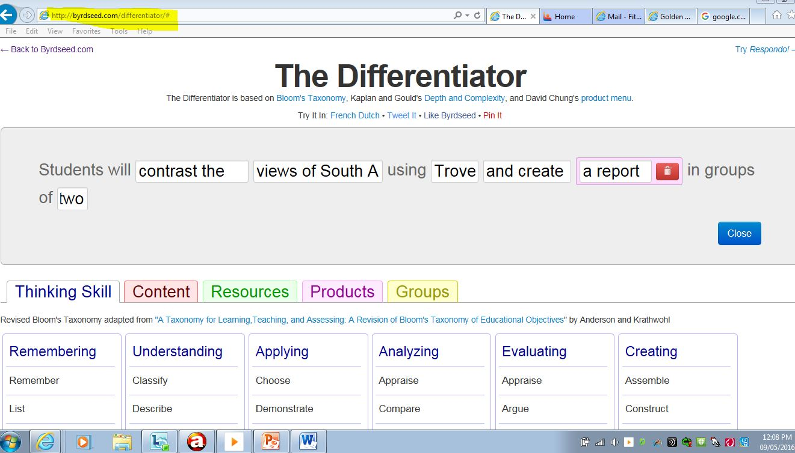
http://byrdseed.com/differentiator/
Notes:
This is a very useful tool to help generated research tasks or topics using all levels of Thinking.

Slide 15
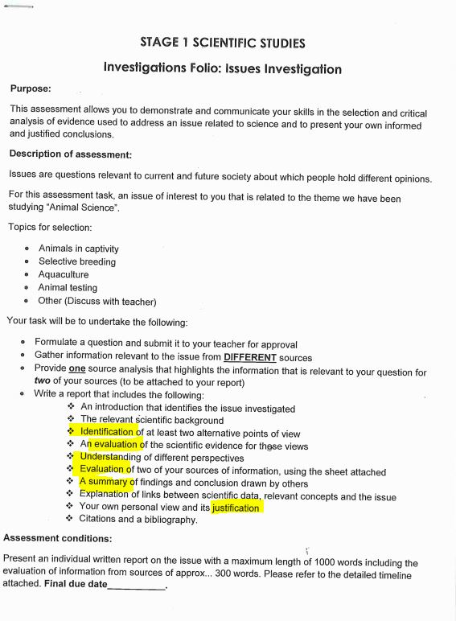
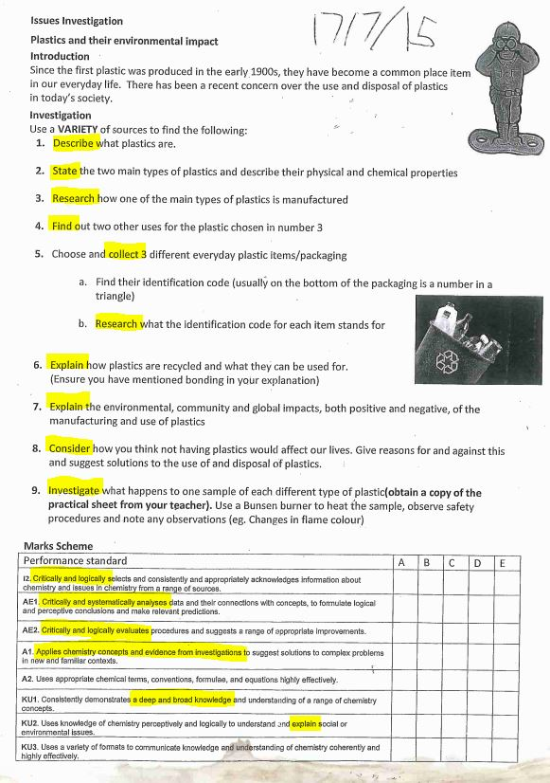
Research Assignment Sheets
Performance Standard
=
“Critically and Systematically analyses”
Explain
Prove / Justify
Investigate
Identify
Versus
Predict
Collect
Find
Create
Notes:
By changing a few words in the Assessment Task, students are automatically moved from lower levels of recall to creating and justifying etc

Slide 16
Authentic Research Task Check-List
Task is fit-for-purpose (in that it enables and encourages students to meet Curriculum requirements Achievement / Performance Standards.
There is scope and opportunity for ‘Assessment for Learning’ not just ‘Assessment of Learning’ in that students are assessed throughout the inquiry process from ‘Defining’ or ‘Creating’ research questions through the process of ‘Evaluating’ information sources.
The task encourages Higher Order Thinking Skills and therefore levels of achievement, specifically for standards such as ‘critical analysis’ and inquiry.
Is differentiated, allows for multiple ways to present evidence of learning at different stage of the Research Based learning process
Is fairly assessable with consistent understandings of Standards and any subject specific assumed knowledge, skills etc (moderation).
Notes:
Use this check list on a current Research Based Learning task Assessment sheet. Consider at what level it addresses the Standards, is there scope to assess learning ‘along the way’? ; How could the questions be re-worded to promote HOTS? Is there a way to differentiate the task, choices or presentation methods, alternative ways to ‘research’ the information? ; Do the students and all the stakeholders (parents, other teachers, SSOs, Moderators etc) clear on how to succeed with this task and what an example of an A. B, C grade might look like?

Slide 17


Certified Educational Assessor
Case Study: Assessing Research
How can you help me help you and others?
Use this information to improve and/or modify an Inquiry or Research Bases Learning Assessment
Implement it with your class
Be willing to answer a few questions about how it went later in the term for my Case Study (Term 2)
Keep talking about Authentic Assessment with teaching colleagues
Notes:
If you would like to help please email me Adam.Fitzgerald869@schools.sa.edu.au or Phone 0407 612 040 or come along and have a chat in Thiele Library.

Slide 18
References
ACARA. (2016). Achievement Standards. Retrieved from Australian Curriculum: http://www.australiancurriculum.edu.au/humanities-and-social-sciences/history/curriculum/f-10?layout=1#level9
J, H., & Timberley, H. (2007). The Power of Feedback. Review of Educational Research, 86.
Kripps, I. (n.d.). Authentic Assessment : Based on SPDU module presented by Ian Krips. Retrieved from http://slideplayer.com/slide/8516463
Kuhlthau, C., Maniatos, L., & Caspari, A. (2012). Guided Inquiry: A Framework for Inquiry in Your School. California: ABC-CLO.
Moon, T. R., & Tomlinson, C. A. (2013). Assessment and Student Success in a Differentiated Classroom. ASCD.
Paul, R. W. (2016, May 9). Six Types of Socratic Questions. Retrieved from Thoughts on Problem Solving: http://www.umich.edu/~elements/5e/probsolv/strategy/cthinking.htm
Whitworth, B., Maeng, J. L., & Bell, R. L. (2013, October). Differentiating Inquiry. Science Scope, 10-11.
William, D. (2006). Does assessment hinder learning? ETS Europe Breakfast Salon.

