Slide 1
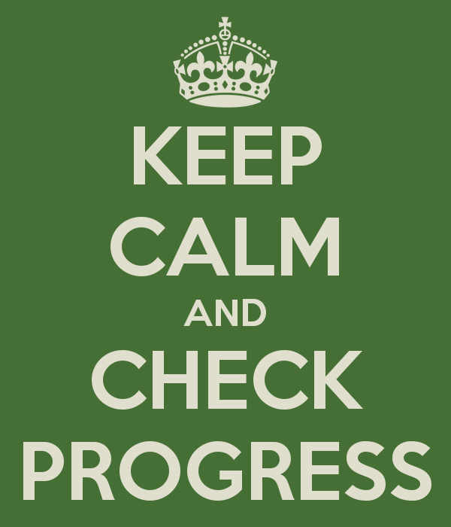
Progress Checks
Assessment Type 2
Assessment Type 2
Activating Identities and Futures

Slide 2
What is/are Progress Check/s?
35 %
Written, oral, or multimodal, using Portfolio examples
1500 words and/or 10 minutes TOTAL
(Can be, for example, 3 minutes / 500 words and 3 minutes)
Discuss learning progress and intended Learning Goal.
Reflect on impact of strategies, perspectives, and feedback
Explain and appraise decisions
Display metacognitive skills

Slide 3
Performance Standard
 | Planning and Acting Developing self-regulation and metacognition Knowing what to do when you don’t know what to do |  | Appraising Developing reflective practice and evaluative judgement Revealing your thinking
 | PA2 Managing time and resources | PA3 Making judgements and decisions. E3 Selecting and using perspectives | A2 Appraising the impact of strategies, perspectives and/or feedback to progress the learning towards the learning goal
A | Strategically manages time and resources with responses to risks and opportunities to progress the learning | Demonstrates discerning judgement and decision-making to progress the learning | Appraises the related impact of strategies, perspectives, and/or feedback to progress the learning towards the learning goal
B | Manages the use of time and resources to progress the learning with awareness of risks and opportunities | Demonstrates informed judgement and decision-making to progress the learning | Appraises the impact of strategies, perspectives, and/or feedback to progress the learning towards the learning goal
C | Manages time and resources to progress the learning | Makes judgements and decisions to progress the learning | Discusses the impact of strategies, perspectives, and/or feedback to progress the learning
D | Completes some tasks | Makes some decisions related to the learning goal | Describes strategies, perspectives, and/or feedback used in the learning
E | Initiates a task | Identifies a process and/or decision related to the learning | Identifies a strategy, perspective, and/or feedback used in the learning

Slide 4
Planning and Acting 2
Managing time and resources
Awareness of risks and/or opportunities
Progressing Learning

Slide 5
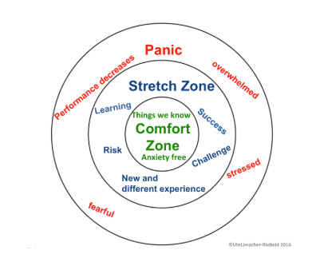
Awareness of Risk/s
Optimal performance zone or Learning Zone

Slide 6
Planning
Knowing what to do when you don’t know what to do
Self-regulation and metacognition

Slide 7
Planning and Acting 3
Demonstrates judgement and decision making
Decisions to progress of learning

Slide 8
Appraising 2
Evaluative Judgement
Impact of strategies, perspectives and/or feedback

